Slide 1
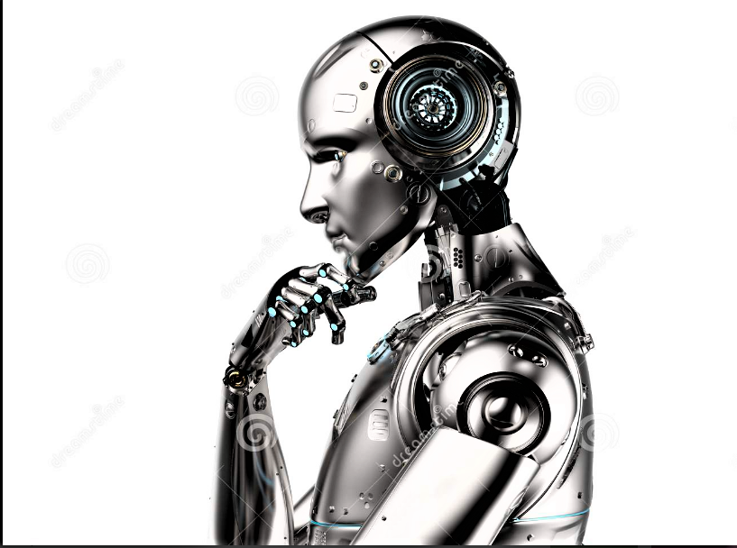
Presentation Topic : ROBOTICS
Name : ABDUL SALAM
Reg.N0:21PWCSE2030

Slide 2
BRAINSTORMING DIAGRAM:
Types 0f
Robots
1) Pre-Programmed Robots
5) Augmenting Robots
3) Autonomous Robots
4) Teleoperated Robots
2) Humanoid Robots

Slide 3
OUTLINES:
What Is Robotics?
Types of Robots
How do robots function?
Main components of a robot
Uses of Robots

Slide 4
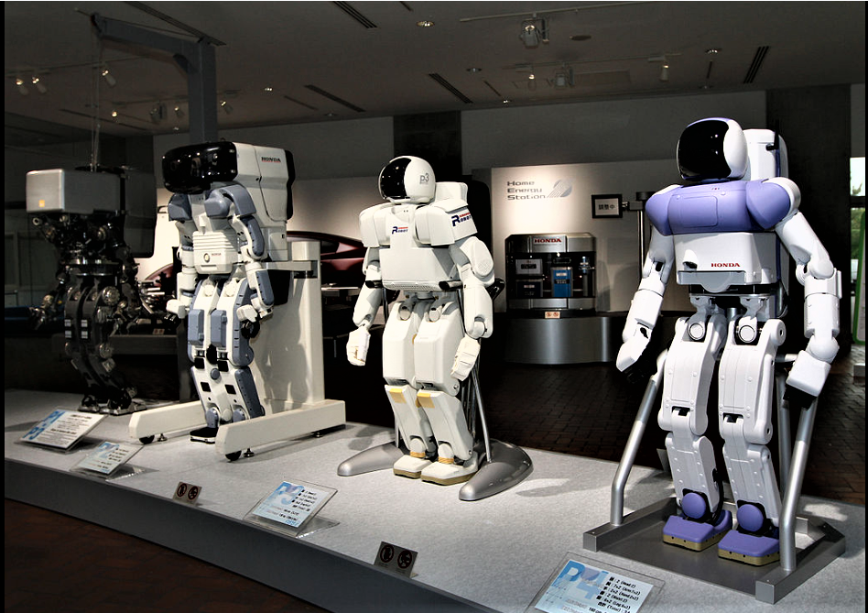
ROBOTICS: Robotics is the intersection of science, engineering and technology that produces machines, called robots, that substitute for (or replicate) human actions.

Slide 5
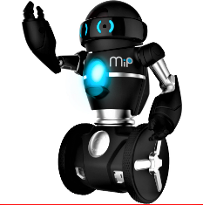
TYPES OF ROBOTS: Generally, there are five types of robots:
1) Pre-Programmed Robots:
Pre-programmed
robots operate in a controlled
environment where they
do simple, monotonous tasks.
Function:
These robots can drive cars, make cars and even fix cars.

Slide 6
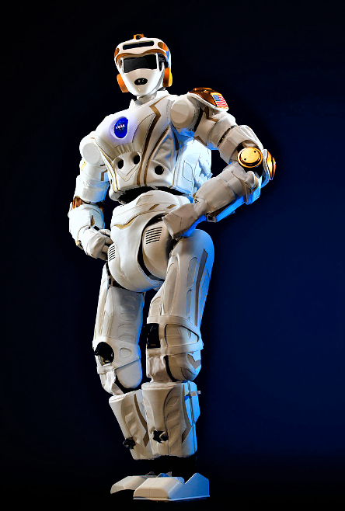
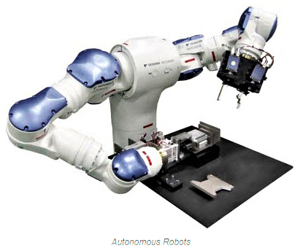
2) Humanoid Robots: Humanoid robots are robots that look like and/or mimic human behavior. Functions: Humanoid robots are used for research and space exploration, education and entertainment. 3) Autonomous Robots: An autonomous robot is a robot that acts without recourse to human control. The first autonomous robots environment were known as Elmer and Elsie. FUNCTIONS: Mobility, intelligence, and cost—from robotic process automation to flying vehicles with artificial intelligence.
Notes:
The first autonomous robots environment were known as Elmer and Elsie.

Slide 7
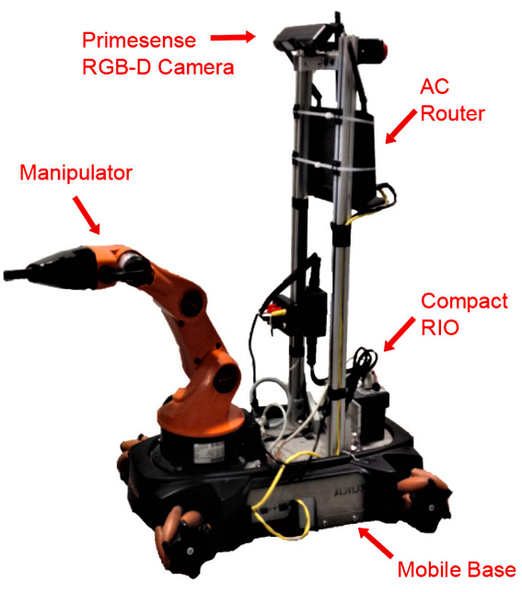
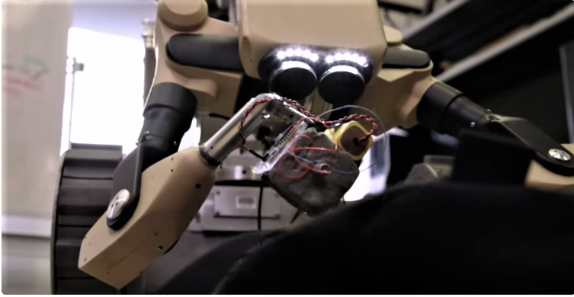
4) Teleoperated Robots : Teleoperated robots are semi-autonomous robots that use a wireless network to enable human control from a safe distance. FUNCTION: These robots usually work in extreme geographical conditions, weather, etc. 5) Augmenting Robots: Augmenting robots generally enhance capabilities that a person already has or replace capabilities that a person has lost. Function: From diffusing bombs to performing surgery, VR is turning people into robots (sort of).

Slide 8
How do robots function? 1)Independent robots: Independent robots are capable of functioning completely autonomously and independent of human operator control. 2)Dependent robots: Dependent robots are non-autonomous robots that interact with humans to enhance and supplement their already existing actions.

Slide 9
Main components of a robot: 1) Control system 2)Sensors 3)Actuators 4)Power Supply 5)End Effectors Uses of Robots: Robots have a wide variety of use cases that make them the ideal technology for the future. Soon, we will see robots almost everywhere. We'll see them in our hospitals, in our hotels and even on our roads.

Slide 10


